Slide 1
Arduino Snake Game on 8x8 LED Matrix..
Mini Project

Slide 2
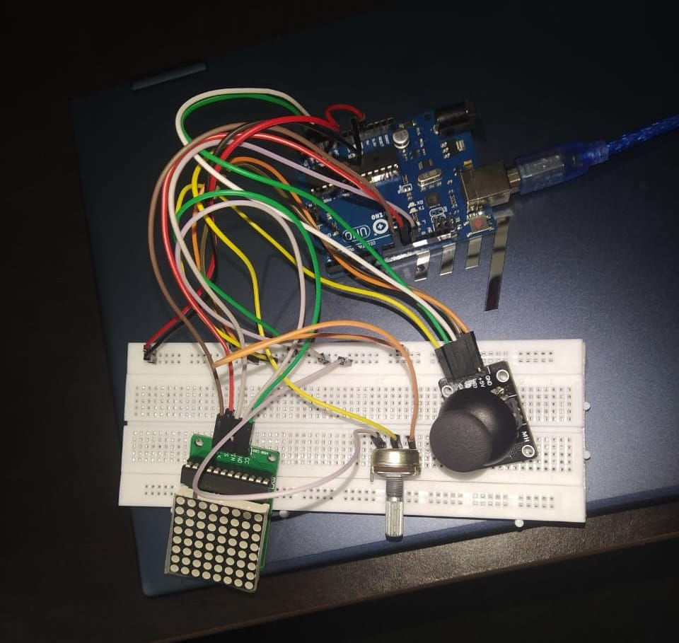
AIM OF THE PROJECT : TO MAKE SNAKE GAME FOR HOBBYIST AND CHILDREN.

Slide 3
COMPONENTS REQUIRED:
ARDUINO UNO
LED MATRIX 8 X 8
ANALOG JOYSTICK
10 K POTENTIOMETER
BREADBOARD
JUMPER WIRES

Slide 4
PROCEDURE of THE WHOLE PROJECT:
First I connected the ground and vcc of breadboard to ground and 5 volt of Arduino. Then I connected joystick vcc and ground to breadboard’s same.
After that , I connected
VRX of joystick – A2 of Arduino ,
VRY of joystick – A3 of Arduino
SW of joystick – 5v
Now I connected LED
VCC – 5V
GND – GND
DIN – 12
CS – 11
CLK – 10
After that Potentiometer
RIGHT – 5V
MIDDLE – A5
LEFT - GND

Slide 5
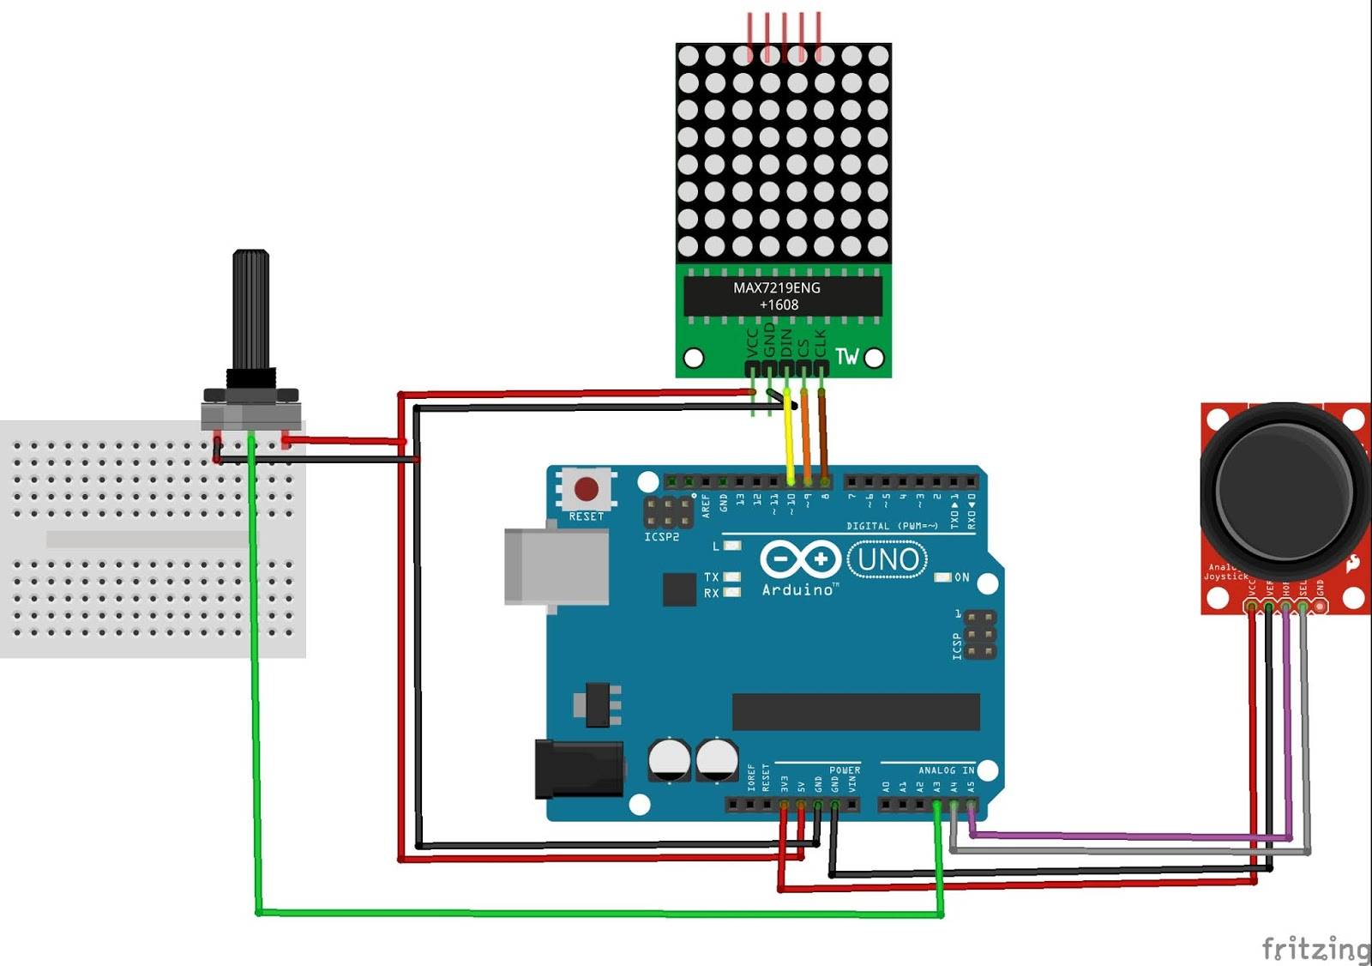
CICUIT DIAGRAM:

Slide 6
Observation:
As we move the joystick snake follow the direction of joystick , as snake eat the food , the length of snake increases by 1 dot. As snake reaches its maximum length it got crashed and finally the score and message of GAME OVER is displayed on screen.

Slide 7
THANK YOU
NAME – DIKSHA BARNWAL
ROLL NO. 2101AI14

